Slide 1
Fuzzy Logic
Kapil Dev Pant (5 hrs)

Slide 2
Contents
Classical Vs Fuzzy Logic
Fuzzy Sets and Membership Functions
Fuzzy Operations
Fuzzy Rule-Based Systems
Fuzzification and Defuzzification
Fuzzy Inference System: Mamdani

Slide 3
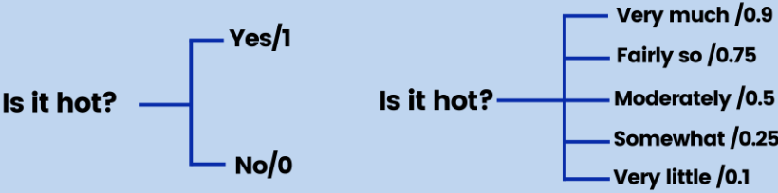
Classical Logic VS Fuzzy Logic
Classical logic is rigid; fuzzy logic is flexible and closer to human thinking.
Classical (Crisp) Logic
Truth values are binary: 0 or 1, True or False. (Sharp Boundaries)
An element either belongs or does not belong to a set.
Suitable for precise, well-defined problems.
Fuzzy Logic
Truth values are continuous, usually between 0 and 1.(gradual boundaries)
An element can partially belong to multiple sets.
Designed to handle vagueness, uncertainty, and human-like reasoning.
Notes:
Applications
Air conditioners
Washing machines
Camera autofocus
Medical diagnosis
Decision support systems
Fuzzy sets allow partial membership, and membership functions quantify this degree of belonging. Together, they provide a mathematical framework to represent uncertainty and imprecision in real-world systems.

Slide 4
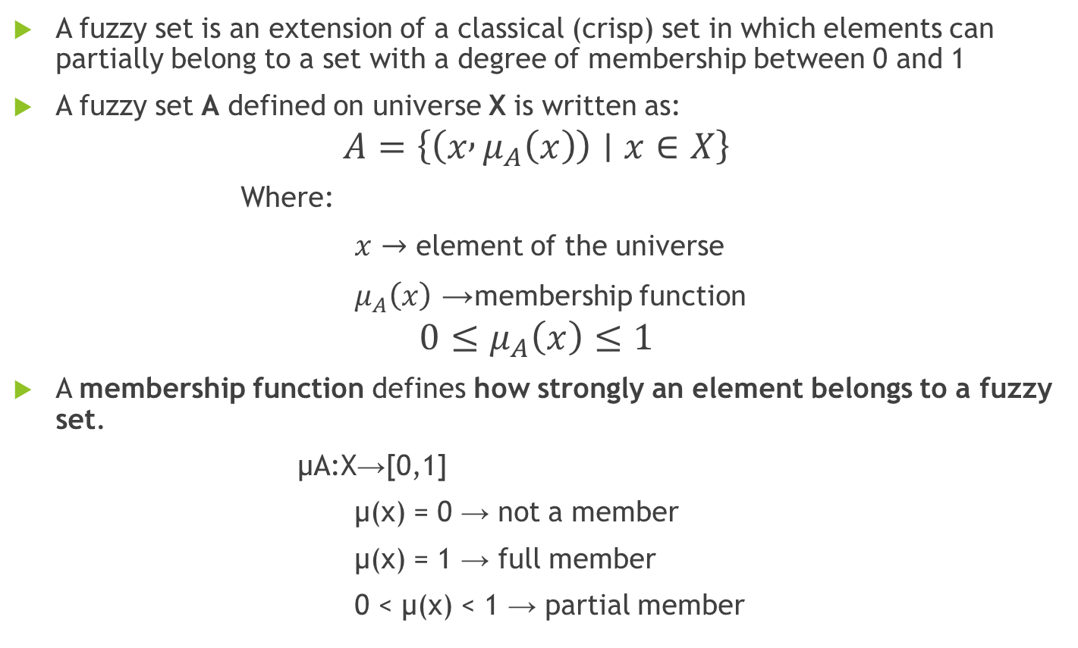
Fuzzy Sets and Membership Functions
A fuzzy set is an extension of a classical (crisp) set in which elements can partially belong to a set with a degree of membership between 0 and 1
A fuzzy set A defined on universe X is written as:
$$A=\left\{\left(x , μ_{A}\left(x\right)\right)∣x∈X\right\}$$
Where:
$x→$ element of the universe
$μ_{A}\left(x\right)$→ membership function
$$0≤μ_{A}\left(x\right)≤1$$
A membership function defines how strongly an element belongs to a fuzzy set.
μA​:X→[0,1]
μ(x) = 0 → not a member
μ(x) = 1 → full member
0 < μ(x) < 1 → partial member
Notes:
Key Characteristics of Fuzzy Sets
No sharp boundary
Handles uncertainty and vagueness
Overlapping sets are allowed
Models human reasoning effectively

Slide 5
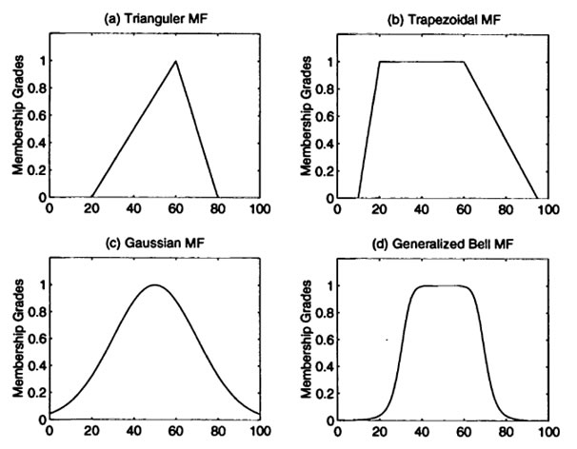
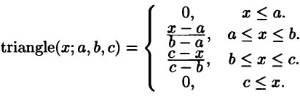
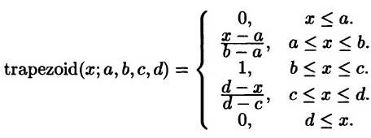


Types of Membership Functions
asda

Slide 6
Fuzzy Operations
These operations i.e. union, intersection, and complement allows for flexible decision-making, pattern recognition, and control systems that mimic human reasoning.
Union (OR): μA∪ B​(x)= max(μA​(x), μB​(x))
OR is dominated by the stronger condition
example: If μA(x) = 0.6 , μB(x) = 0.8 Then: 𝜇 𝐴∪𝐵(𝑥)=0.8
Intersection (AND): μA∩ B​(x)=min(μA​(x),μB​(x))
The truth of AND is limited by the weaker condition.
example: if μA(x) = 0.7 , μB(x) = 0.5, then μA∩B​(x)=0.5
Compliment (NOT): μAˉ​(x)=1−μA​(x)
Degree of “NOT A” is the opposite of “A”.
example: If μA(x) = 0.3, Then: 𝜇¬𝐴(𝑥)=0.7
Notes:
Alternative Fuzzy Operators (Advanced – Mention for Higher Marks)
Algebraic Product (AND)
$μ_{A∩B}\left(x\right)=μ_{A}\left(x\right)×μ_{B}\left(x\right)$.
Algebraic Sum (OR)
$μ_{A∪B}\left(x\right)=μ_{A}\left(x\right)+μ_{B}\left(x\right)−μ_{A}\left(x\right)μ_{B}\left(x\right)$
Bounded Difference (AND)
$max⁡\left(0 , μ_{A}\left(x\right)+μ_{B}\left(x\right)−1\right)$
Bounded Sum (OR)
$min⁡\left(1 , μ_{A}\left(x\right)+μ_{B}\left(x\right)\right)$

Slide 7
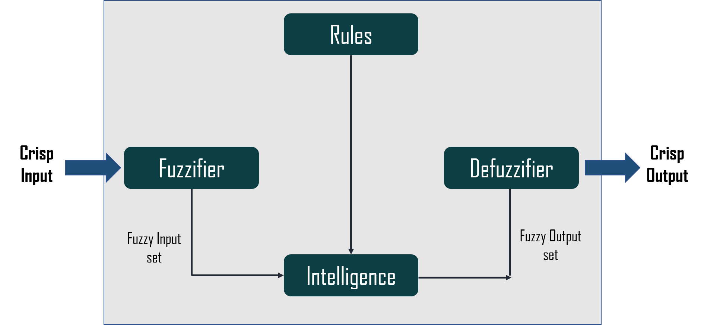
Fuzzy Learning
Fuzzy learning combines fuzzy logic with machine learning. It deals with uncertainty and imprecision in data. Useful in systems that mimic human reasoning.
Unlike binary logic (0 or 1), fuzzy logic allows degrees of truth (e.g., 0.2, 0.7).
Components of Fuzzy Systems
Rule Base: Set of fuzzy IF-THEN rules and membership function.
Fuzzification: Converts crisp inputs into fuzzy values.
Inference Engine: Applies rules to generate fuzzy outputs.
Defuzzification: Converts fuzzy outputs back to crisp values.
Fuzzy Rule-Based Learning
Learns rules from data or expert knowledge.
Example: IF temperature is high AND humidity is low THEN fan speed is high.
Rules can be learned using decision trees or optimization methods.

Slide 8
Fuzzification
Fuzzification is the process of converting crisp (numerical) input values into fuzzy values by determining their degrees of membership in corresponding fuzzy sets.
-To make real-world data suitable for fuzzy reasoning
-To express input information in linguistic terms
How Fuzzification Works
Take a crisp input value
Apply predefined membership functions
Compute membership degrees (between 0 and 1)
Notes:
Types of Fuzzification
Singleton fuzzification (most common)
Non-singleton fuzzification
Characteristics
Input → fuzzy sets
Based on membership functions
No decision is made at this stage

Slide 9
Defuzzification
Defuzzification is the process of converting the fuzzy output obtained from the inference engine into a single crisp output value.
To obtain a usable control signal
To apply fuzzy decisions in real-world systems
Why Defuzzification is Needed
Machines and actuators:
Cannot work with fuzzy values
Require exact numerical values
Notes:
Types of Fuzzification
Singleton fuzzification (most common)
Non-singleton fuzzification
Characteristics
Input → fuzzy sets
Based on membership functions
No decision is made at this stage

Slide 10
Methods of defuzzification
Center of Sums Method (COS)
Center of gravity (COG) / Centroid of Area (COA) Method
Center of Area / Bisector of Area Method (BOA)
Weighted Average Method
Maxima Methods
First of Maxima Method (FOM)
Last of Maxima Method (LOM)
Mean of Maxima Method (MOM)

Slide 11

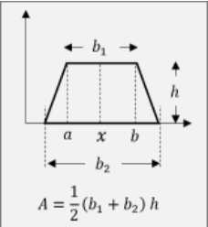
Methods of defuzzification
Center of Sums Method (COS)
Where Ai is area of region
Xi = geometric center of that area
overlapping is counted twice or calculated as isolated

Slide 12
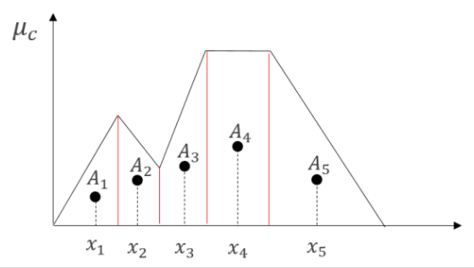
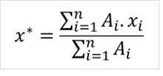
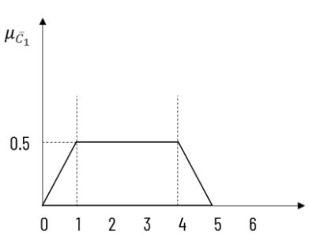
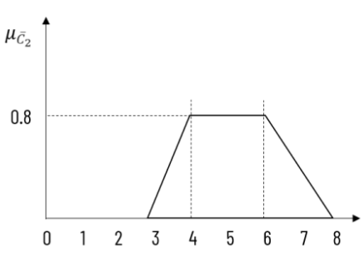
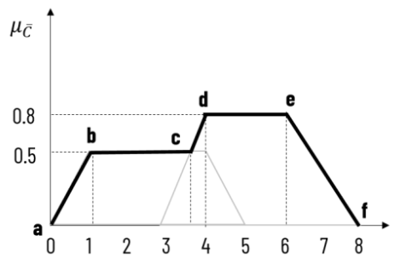
Methods of defuzzification
Center of gravity (COG) / Centroid of Area (COA) Method
Same as COS but overlapped

Slide 13
Fuzzy Inference System: Mamdani
Named after Ebrahim Mamdani who first proposed it in 1975.
This model is used to derive a fuzzy output from a set of fuzzy inputs based on a set of fuzzy rules.
Steps in Mamdani Fuzzy Inference System:
Fuzzification: Convert crisp inputs into fuzzy sets using membership functions.
Rule Evaluation: Apply the fuzzy inputs to the antecedents of the fuzzy rules and determine the firing strength of each rule.
Aggregation: Aggregate the outputs of each rule (the consequents) into a single fuzzy set.
Defuzzification: Convert the aggregated fuzzy set into a crisp output.

Slide 14
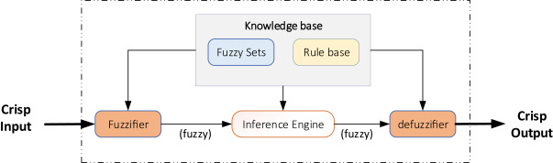
Architecture and Components
Notes:
1. Rule Base
Collection of fuzzy IF-THEN rules
Format: IF (antecedent) THEN (consequent)
Both antecedent and consequent use linguistic variables
Example: "IF temperature is Hot AND humidity is High THEN fan_speed is Fast"
2. Fuzzifier
Converts crisp inputs to fuzzy sets
Uses membership functions to determine degree of membership
Multiple membership functions for each input variable
3. Inference Engine
Evaluates fuzzy rules
Determines firing strength of each rule
Aggregates multiple rule outputs
4. Defuzzifier
Converts fuzzy output to crisp value
Several methods available (centroid, bisector, etc.)

Slide 15
Step 1: Fuzzification
For each input variable, we determine the degree to which it belongs to each of the appropriate fuzzy sets via membership functions.
Example:
Input: Temperature = 28°C
Membership functions:
Cold: μ = 0.0
Warm: μ = 0.3
Hot: μ = 0.7

Slide 16
Step 2: Rule Evaluation
Each rule in the rule base is evaluated. A rule typically has the form: IF x1 is A1 AND x2 is A2 ... THEN y is B
The antecedent (IF part) is evaluated by combining the membership degrees of the input variables (using AND/OR operators).
The AND operator is typically implemented as min (minimum of the membership degrees) and OR as max (maximum).
The firing strength of a rule is the degree to which the antecedent is satisfied.
Example:
Rule 1: IF temp is Hot AND humidity is High THEN speed is Fast
temp μ(Hot) = 0.7, humidity μ(High) = 0.4
α₁ = min(0.7, 0.4) = 0.4 (using AND as minimum)
Rule 2: IF temp is Warm THEN speed is Medium
temp μ(Warm) = 0.3
α₂ = 0.3

Slide 17
Step 3: Aggregation
The consequents (THEN part) of all rules are combined into a single fuzzy set.
Each rule's consequent is clipped (or scaled) by the rule's firing strength.
The aggregated output is the union (max) of all the clipped consequents.
Example:
Take the UNION (maximum) of all clipped/scaled output membership functions
Result: A single fuzzy set representing the combined output

Slide 18
Step 4: Defuzzification
The aggregated fuzzy set is then defuzzied to obtain a crisp output.
Common methods for defuzzification include:
Centroid (center of gravity): The most common method, which calculates the center of the area under the curve.
Bisector: The point that divides the area into two equal parts.
Mean of maximum (MOM): The average of the maximum values of the aggregated output.
Smallest of maximum (SOM), and Largest of maximum (LOM).

Slide 19
Example: Air Conditioner Control
Input Variables:
Temperature: {Cold, Warm, Hot}
Humidity: {Low, Medium, High}
Output Variable:
Fan Speed: {Slow, Medium, Fast}
Rules:
IF temp is Hot AND humidity is High THEN speed is Fast
IF temp is Warm AND humidity is Medium THEN speed is Medium
IF temp is Cold THEN speed is Slow
Crisp Inputs:
Temperature = 28°C → μ(Hot)=0.7, μ(Warm)=0.3, μ(Cold)=0
Humidity = 70% → μ(High)=0.4, μ(Medium)=0.6, μ(Low)=0
Calculations:
Rule 1: α₁ = min(0.7, 0.4) = 0.4 → Clip "Fast" at 0.4
Rule 2: α₂ = min(0.3, 0.6) = 0.3 → Clip "Medium" at 0.3
Rule 3: α₃ = min(0, ...) = 0 → No effect
Aggregate:
Take max of clipped functions
Defuzzify:
Calculate centroid → Output: 65% fan speed

Slide 20
Mamdani Model
Advantages
Intuitive - Easy to understand and interpret
Human-like reasoning - Mimics human decision-making
Well-suited for expert knowledge - Rules come from human experts
Smooth output - Provides gradual control changes
Robust - Tolerates imprecise inputs well
Disadvantages
Computationally expensive - Especially defuzzification step
Complex with many rules - Can become unwieldy
Difficult mathematical analysis - Hard to prove stability
Rule explosion problem - Many rules needed for complex systems

Slide 21
Real-world applications
Used for dynamic supportive networks and individual assessments in the huge organization business.
Controls the pH, drying, and concoction refining process in the substance business.
Fuzzy rationale is used in natural language processing.
Widely used in present-day control frameworks, for example, master frameworks.

Slide 22
Questions & Discussion

